Slide 1


SMART INDIA HACKATHON 2025
TITLE PAGE
Problem Statement ID –25179
Problem Statement Title -Quantum Secure Email Client Application
Theme- Blockchain & Cybersecurity
PS Category- Software
Team ID-
Team Name- Team Quantum

Slide 2


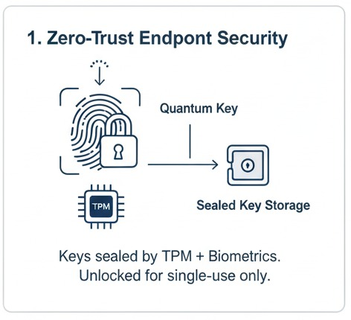
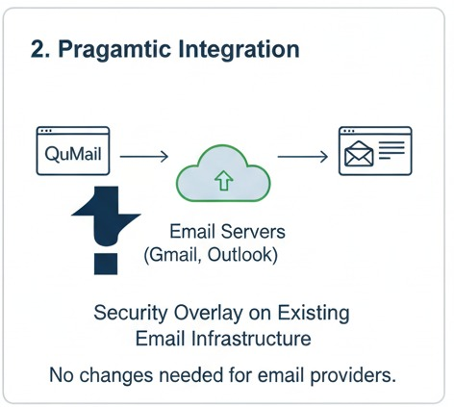
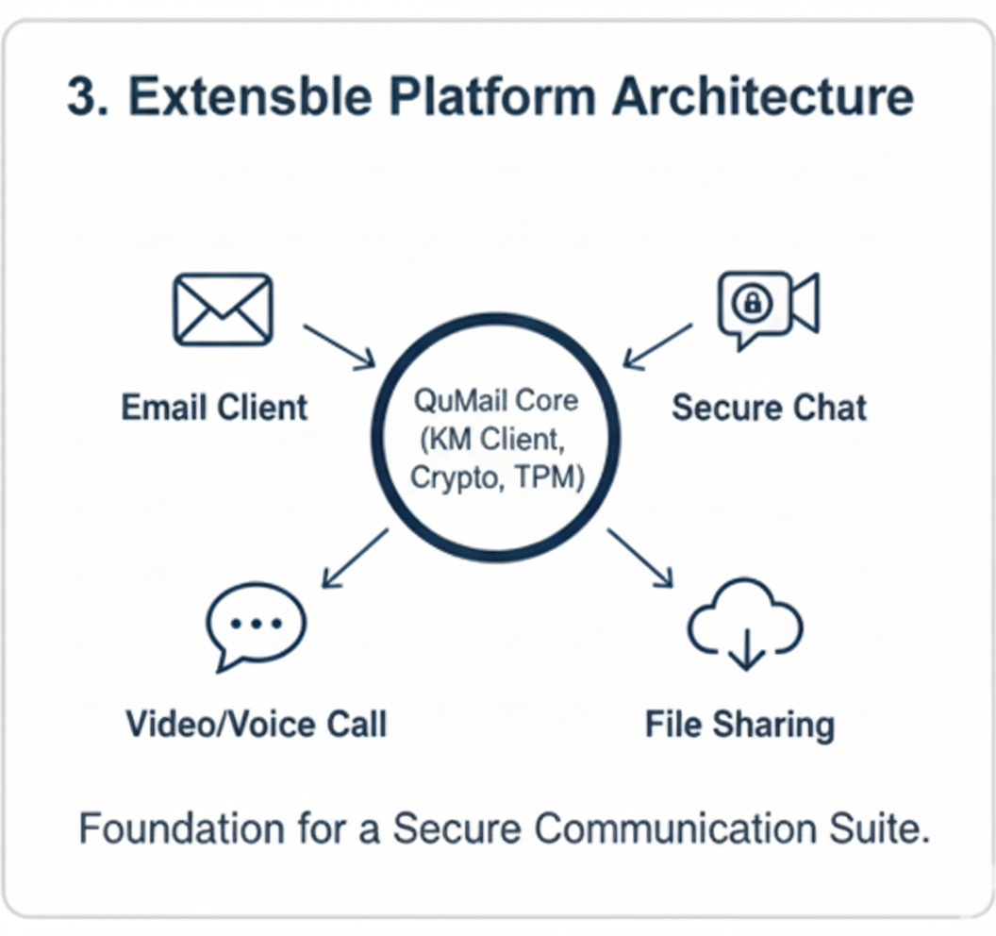
Qu-Mail
Proposed Solution:
We are developing Qu-Mail, a secure email client that works like Outlook or Gmail but adds quantum-level security.
The application connects with a Key Manager (KM) that provides quantum-generated secret keys using international standards (ETSI GS QKD 014).
These keys are then used by Qu-Mail to encrypt emails and attachments before they are sent over the internet. On the receiver’s side, Qu-Mail retrieves the same quantum key from their local KM and decrypts the email securely
Security Modes Offered:
How it Addresses the Problem:
Protects emails from being decrypted by future quantum computers.
Prevents store-now, decrypt-later attacks, where adversaries save emails today to crack them in the future.
Builds trustworthy and future-proof communication beyond classical encryption.
Secures attachments and sensitive data sent over untrusted networks.
Innovation & Uniqueness
Quantum One Time Pad
Quantum Aided AES
Post Quantum Cryptography
Normal Mode
@SIH Idea submission- Template
2

Slide 3
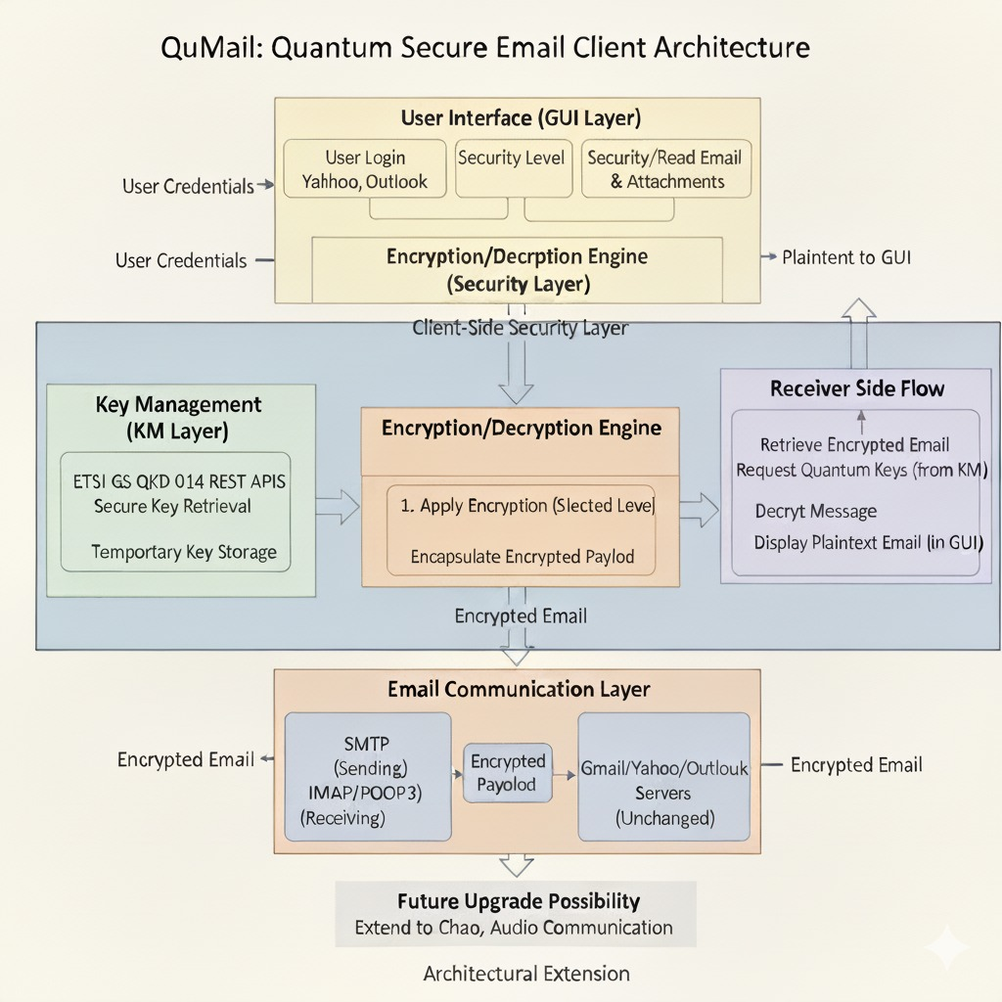



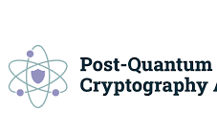


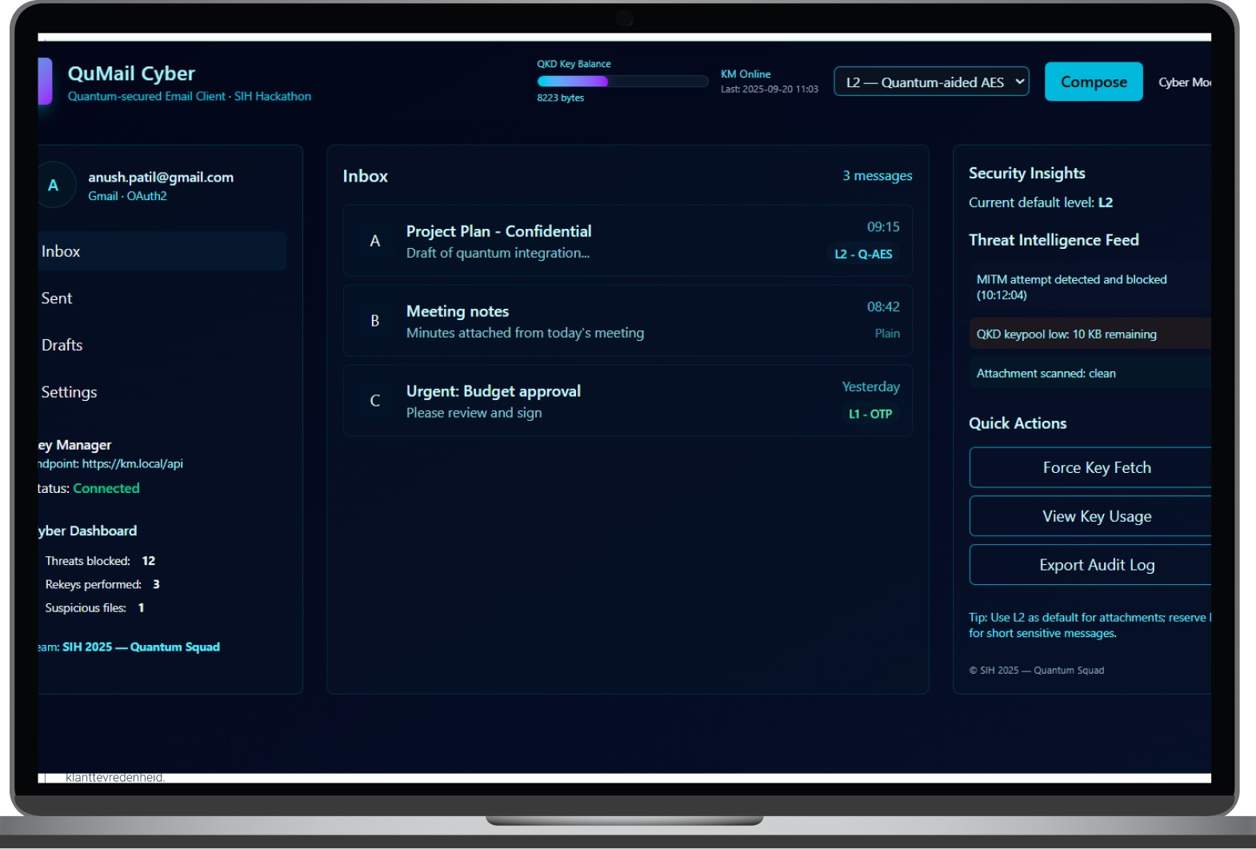
TECHNICAL APPROACH
Technical stack

Slide 4
FEASIBILITY AND VIABILITY
Technical Feasibility
It's cost-effective as it uses existing email services, and it solves a huge problem (quantum threats), so there's clear demand.
Time Feasibility
Economic Feasibility.
Operational Feasibility
We use proven industry standards (ETSI QKD API) and standard email tech (SMTP/IMAP). We can simulate the QKD key system now, making it fully testable.
It works like any email app, so users will find it easy to use daily.
We can build a working demo in the hackathon and quickly expand it afterward for real world scenarios.
Potential Challenges and Risks
QKD Network Access: Real quantum networks are not everywhere yet.
Key Manager (KM) Uptime: If the key server goes down, keys can't be delivered.
Getting Users to Switch: People are used to Gmail/Outlook.
Speed: Getting keys and encrypting might make things a bit slower.
Strategies to Overcome Challenges
For Network Access: If QKD is offline, we automatically use Post-Quantum Cryptography (PQC). You're always quantum-safe Implement .
For KM Uptime: We'll design the KM for high reliability and the app will temporarily cache keys so you don't notice minor issues.
For User Adoption: We'll make Qu-Mail super simple and familiar to use, hiding all the complex security in the background.
For Speed: We'll use fast, efficient encryption methods that run smoothly in the background, so your email experience stays quick.

Slide 5
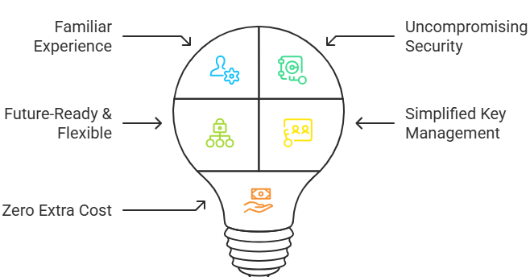
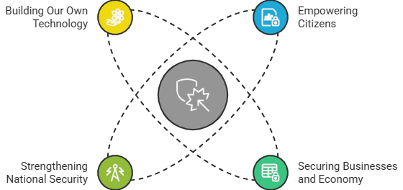
IMPACTS AND BENEFITS
Impact:
Empowering Citizens: Guarantees every individual’s personal data is safe in the quantum era.
Securing Businesses and Economy: Safeguards companies’ ideas and trade secrets to protect economic growth.
Strengthening National Security: Provides secure communication for our defenses, intelligence (RAW).
Building Our Own Technology: Develops India’s quantum-safe tools to reduce foreign reliance and ensure digital independence.
Benefits of the Solution:
Uncompromising Security: Quantum-safe QKD encryption makes communications unbreakable.
Familiar Experience: Works just like a regular email client (Outlook, Gmail), requiring no changes.
Future-Ready & Flexible: Offers different security levels for various needs and can extend to chat, video, and file sharing.
Simplified Key Management: Centralized Key Manager (KM) handles key distribution, freeing users from complex cryptographic tasks.
Zero Extra Cost: Integrates with existing email providers without new infrastructure.
@SIH Idea submission- Template
5

Slide 6
RESEARCH AND REFERENCES
Research Papers And Articles
NSA Guidance:-Quantum Key Distribution (QKD) / Quantum Cryptography (QC)
Research Gate:-Integrating Quantum Key Distribution into Email Systems
NIST:-NIST Post-Quantum Cryptography
Open Quantum Safe (OQS) Project:-The liboqs library is a key component for our PQC implementation (level 3).
QKD :-Safeguarding for the Future :- IEEE Communications Society article
QKD for Sustainable and Secure Communication:- potential benefits of quantum key distribution (QKD) to provide secure communication channels.
Authentication of quantum key:-distribution with post-quantum cryptography and replay attacks
Authentication of Variable Length Messages in Quantum Key Distribution:-Authentication of variable length messages in QKD
Feasible Quantum Protocol for Identity-Based Signature with Application to Secure Email Communication :a quantum protocol for identity-based signatures (IBS) and simulates it using quantum tools
Standard Protocols
Key Standards & Protocols:
ETSI GS QKD 014: Quantum Key Distribution (QKD); Protocol and data format of REST-based key delivery API.
RFC 5321 & 5322: Simple Mail Transfer Protocol (SMTP).
RFC 3501: Internet Message Access Protocol (IMAP).
Cryptographic References:
NIST Post-Quantum Cryptography (PQC) Standardization Project: For selecting a suitable PQC algorithm (e.g., CRYSTALS-Kyber).
Advanced Encryption Standard (AES): FIPS PUB 197.

